Slide 1

COWS AND BULSS
THE WORD GAME

Slide 2
Team Name: Kapoor Brothers
TEAM MEMBERS
Manit Kapoor
Madan Kapoor
GUIDE:
Mrs Gunasundari

Slide 3
Abstract
Cows and Bulls is an old code breaking mind or paper and pencil game. It is a game with numbers or words that may date back a century or more. This game helps us to increase our thinking capabilities and glossary. This game is developed for windows using GIMP tool kit using C language. GUI is also improved using CSS. Words are taken from www.morewords.com.

Slide 4
Objective
To improve code-breaking skills of students
To improve vocabulary
To improve combinatorial thinking skills

Slide 5
Requirements
Operating System | Windows(from XP onwards)
Hard Disk Space | 86 Mb
Free Hard Disk Space | 500 Mb
RAM | 128 Mb

Slide 6
Implementation
Application Layer using GTK+
Internal implementation using C
Storage medium-Indexed File access system

Slide 7
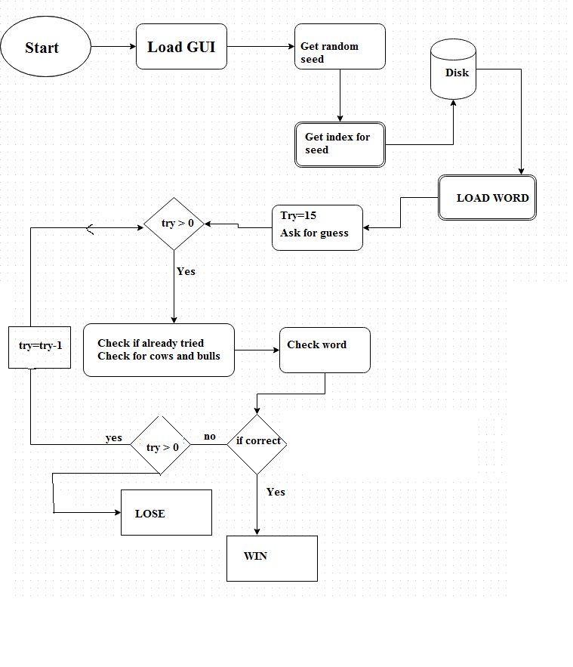
Flowchart

Slide 8
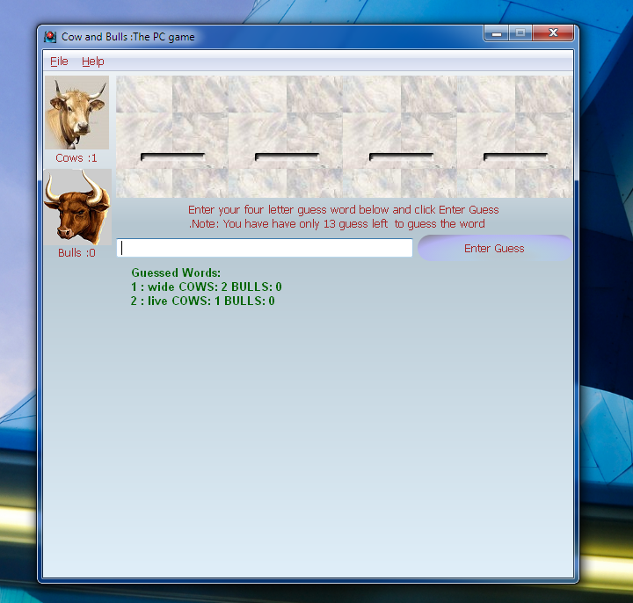

Slide 9
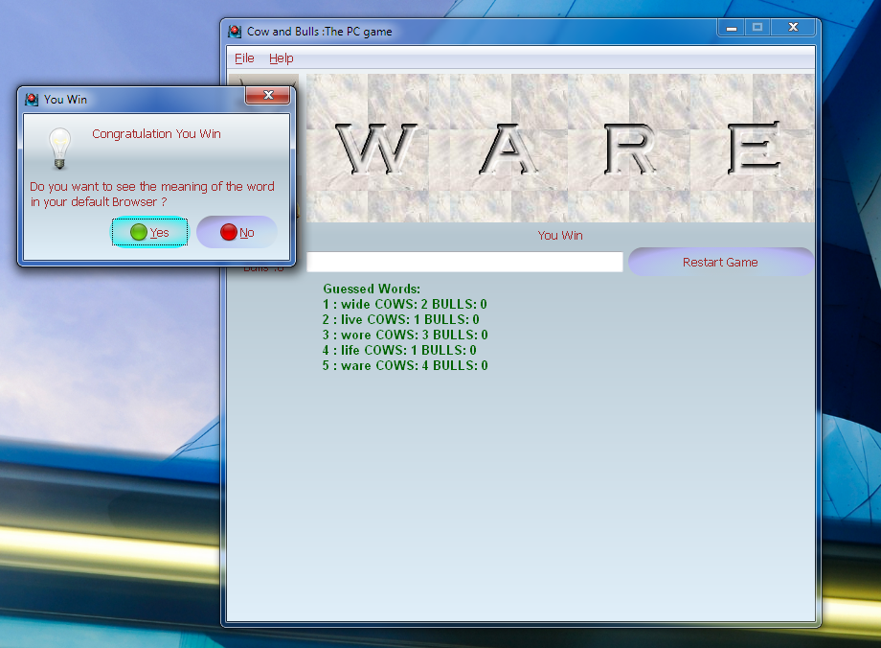

Slide 10
